Slide 1
Strategic Site Matrix: MAR-2015
Region | Country | Belfast | Budapest | Buffalo | Dalian | Heredia | Makati City | Mexico City | Mumbai | Shanghai | Tampa | TCS Chennai | TCS Gurgaon | Regulatory Restricted | Other (non-centralized and discontinued ops) | Total
APAC | INDIA |  |  |  |  | 8,592 |  |  |  |  |  |  |  | 1,481 | 1,535 | 11,608
APAC | PHILIPPINES |  |  |  |  | 30 |  |  |  |  |  |  |  |  |  | 30
APAC | TAIWAN | 26 | 44 | 20 | 11 | 691 | 168 | 74 | 249 | 75 | 95 | 90 | 18 | 378 | 20 | 1,959
APAC | THAILAND |  |  | 1 |  | 62 |  |  | 1 |  |  |  |  | 1 |  | 65
EMEA | GERMANY |  |  |  |  | 1,102 |  |  |  |  |  |  |  |  |  | 1,102
EMEA | KAZAKHSTAN | 73 | 68 | 73 | 5 | 16 | 743 | 80 |  |  | 38 |  |  |  | 3 | 1,099
LATAM | COSTA RICA | 58 | 48 |  |  | 29 |  | 26 |  |  | 954 |  |  |  |  | 1,115
LATAM | PANAMA | 78 | 127 |  |  | 344 | 108 | 48 | 55 | 42 | 211 | 105 | 12 |  | 49 | 1,179
NAM | UNITED STATES | 459 | 55 | 12 | 11 | 1,119 | 20 | 115 | 54 | 104 | 8 | 4 | 99 |  | 1 | 2,061
 | Total | 694 | 342 | 106 | 27 | 11,985 | 1,039 | 343 | 359 | 221 | 1,306 | 199 | 129 | 1,860 | 1,608 | 20,218
CONFIDENTIAL

Slide 2
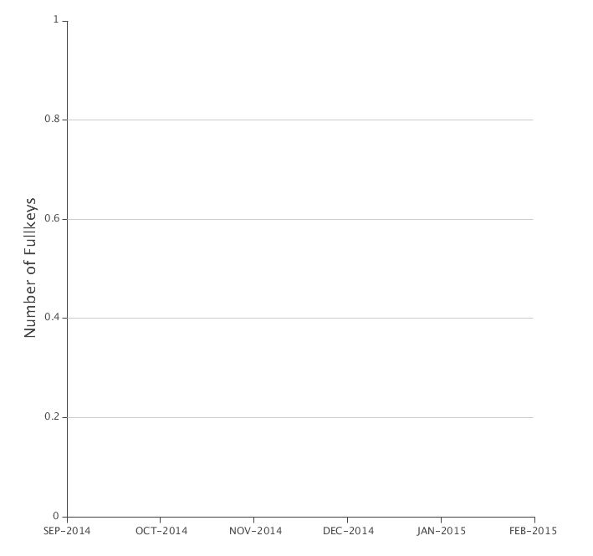
6 Month Trend Report by Strategic Site
CONFIDENTIAL

Slide 3
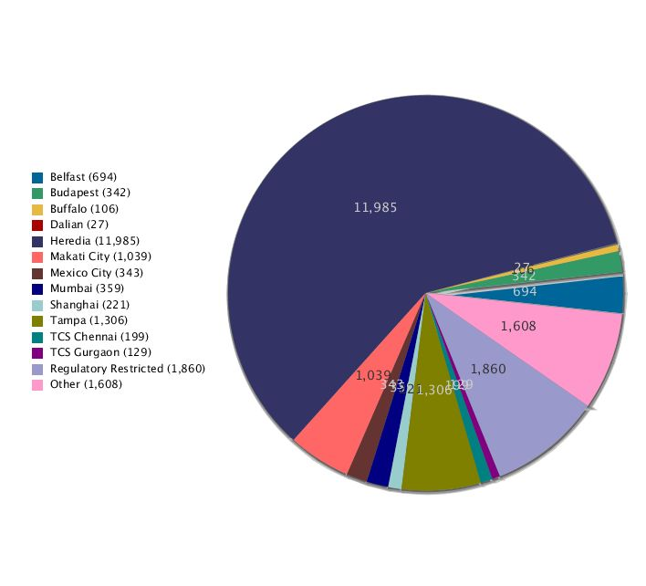
Number of Fullkeys by Strategic Site: MAR-2015
CONFIDENTIAL

